Slide 1
The structure of a shortest path
By
Mr. Gururaj
Assistant Professor-Selection Grade
Department of Computer Science & Engineering
M.I.T Manipal

Slide 2



Shortest paths and matrix multiplication

Slide 3
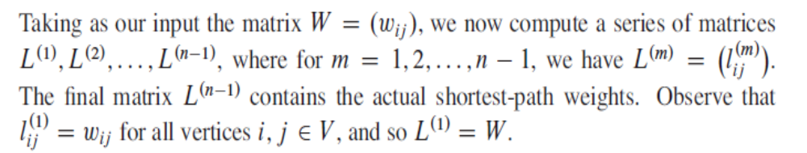
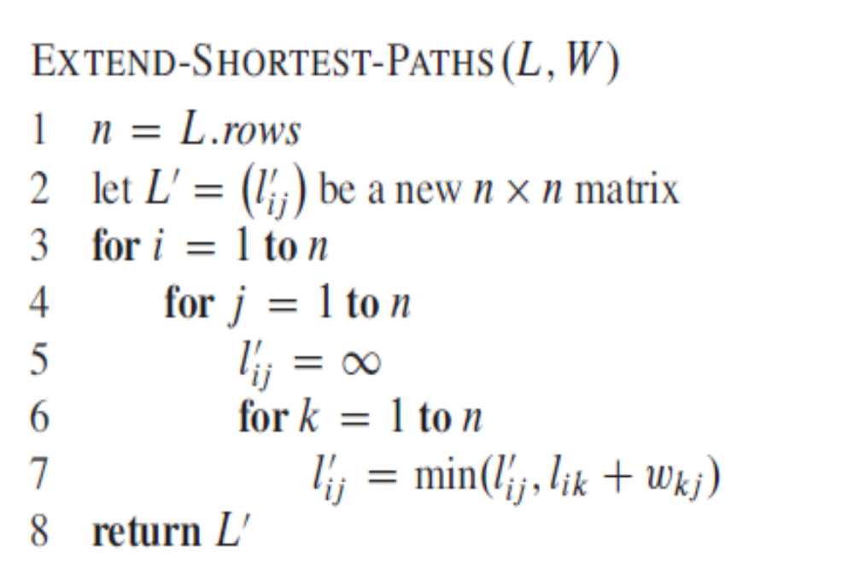
Computing the shortest-path weights bottom up

Slide 4
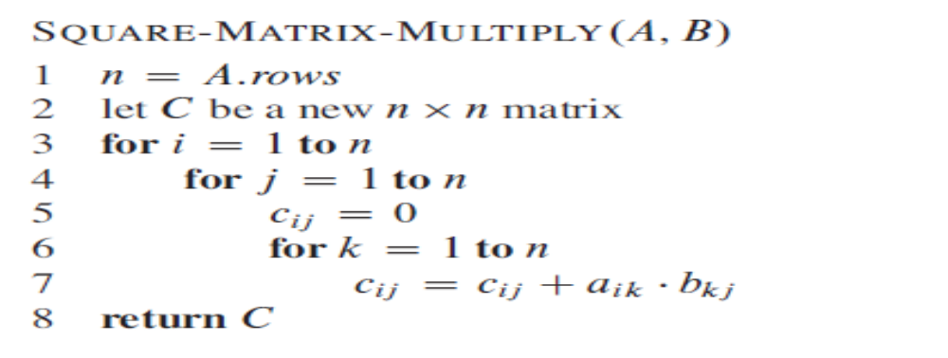
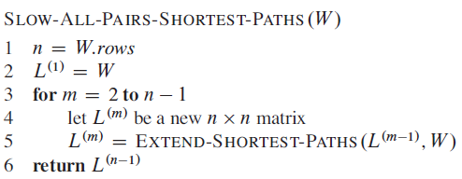

Slide 5
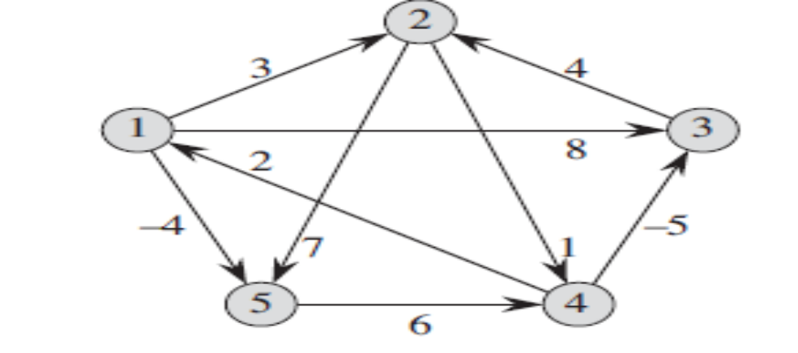
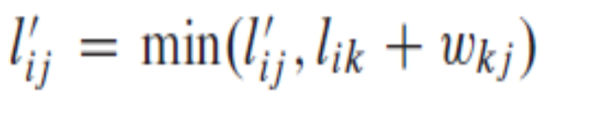



Slide 6
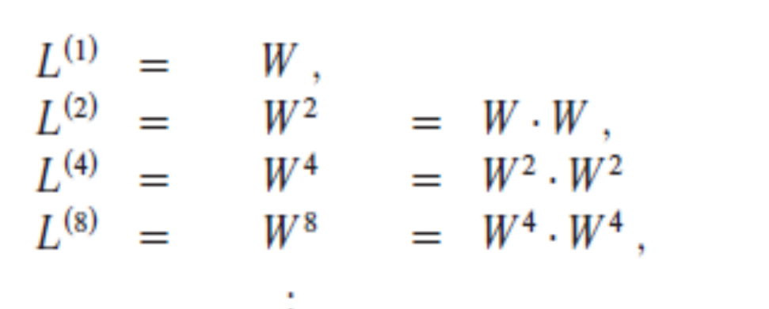
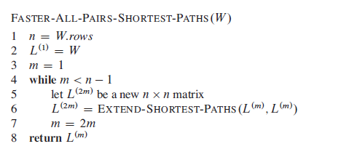
Improving the running time

